Slide 1
Supermarket dataset
Parin kittipongdaja
M.Sc. CSIS : Data Science
Presentation for Applying Data Scientist Position @ Data Café Thailand

Slide 2
Introduction
The supermarket dataset describes the spending, product, and shopping date of supermarket customer. The dataset also consists of sales of the supermarket which have recorded in 4 different branches for one year and six months of data. We can use this information to find the pattern of customer behavior and extract the insight that brings them into business action.
Notes:
The supermarket dataset describes the spending, product, and shopping date of supermarket customer. The dataset also consists of sales of the supermarket which have recorded in 4 different branches for one year and six months of data. We can use this information to find the pattern of customer behavior and extract the insight that brings it into business action.

Slide 3
Column Description
SHOP_DATE : Date when shopping has been made. Date is specified in the yyyymmdd format SHOP_HOUR : Hour slot of the shopping 0=00:00 …23=23:00 -00:59, 1=01:00 -23:59 -01:59, BASKET_ID : Basket ID. All items in a basket share the same basket_id value. CUST_CODE : Customer Code STORE_CODE : Store Code PROD_CODE : Product Code QUANTITY : Number of items of the same product bought in this basket SPEND : Spend associated to the items bought

Slide 4
business questions
1. What is the sales amount of the supermarket in hourly time? - to find which period of the day is a poor performance that we will set up a promotion for increasing sales.
2. Which product can generate the highest sales and number of the customer? - To find a profile of the top sale product that can let the supermarket import a similar product to increase the sales.
3. What customer distribution look like? - To find which customer group profile spending the most.
4. Which store has the most top performance? - To figure out whether location is affect the sales amount.
Notes:
ดูว่าช่วงไหน ยอดขายไม่ดี จะได้ จัด promotion ช่วง นั้น เพื่อกระตุ้นยอดขาย
ดูว่า Product ที่ขายดี และลูกค้าให้ความสนใจมาก จะได้หา สินค้าที่มีลักษณะเดียวกันมาขายเพิ่ม
3. เพื่อที่ว่า จะทำยังไง ให้ลูกค้า มาบ่อยขึ้น เพื่อเพิ่ม % Active LTM ซึ่งจะทำให้ลูกค้ามีโอกาส Spend มากยิ่งขึ้น
4. ถ้า Location ไม่มีผล เช่น ตอนนั้นยอดตก ก็คือ ตกทุกสาขา จะได้ ตัดสาเหตุจาก location ทิ้งไป

Slide 5

Analytics Techniques
We are using Tableau for analyzing which can get actionable insights fast and make awesome analyzing interactive visualization.
for Clustering Analysis, we use K-means Algorithm in Tableau.

Slide 6
Preparing Data
Before we begin the analysis, we must connect to our data and then set up the data source. We use Tableau to connect the data source name ‘supermarket_data.csv’
The data come in eight columns then we convert the data type to type as proper follow: SHOP_DATE : Date SHOP_HOUR, BASKET_ID, CUST_CODE, STORE_CODE, PROD_CODE: Dimensions or object QUANTITY, SPEND: Measures or numeric

Slide 7
Processing Step (1/4)
According to business questions, we will create four dashboards to answer four questions include ‘sales profile’, ‘Product Profile’, ‘Customer Profile’, ‘Store Profile’
sales profile
Create shop hour performance chart by using ’Shop hour’ and ‘Spend’ columns.
Create sales trend chart by using ‘Spend’ and ‘Shop date’ column.
Create new measures name ‘Price’ by using ‘Sales’ and ‘Quantity’ column.
Ranking the product order by Sales, Quantity, and Price.

Slide 8
Processing Step (2/4)
Product Profile
Create product distribution bubble chart by using Count distinct of ‘Basket id’ and ‘Cust code’ columns, ‘Spend’ column as size of bubble, and use these three column for Clustering Analysis into three clusters.
Ranking product by Price and Sales.

Slide 9
Processing Step (3/4)
Customer Profile
Create new dimensions name ‘﻿Shop Date (Month / Year)’ using ‘Shop date’ column to extract only year and month.
Create new Measures name ‘No. of LTM’ using ﻿COUNT Distinct of ‘Shop Date (Month / Year)’ to count number of visiting of each customer.
Create new Measures name ‘Total LTM’ using different first and last time ﻿’Shop date’ to calculate total lifetime of each customer.
Create new Measures name ‘% Active LTM’ using ‘No. of LTM’ and ‘Total LTM’ to calculate the percentage of active lifetime.
Create customer distribution chart using ‘% Active LTM’ and ‘Spend’ column and use ‘Spend’ column for Clustering Analysis into three clusters.

Slide 10
Processing Step (4/4)
Store Profile
Create new Measures name ‘Sales per month’ using ‘Sales’ and ‘Shop date’ column to calculate sales per month.
Create store profile chart using Count distinct of ‘Cust Code’ and ‘ Sales per month’ and separate by ‘store Code’ into each quarter to look profile of sales of each store.

Slide 11
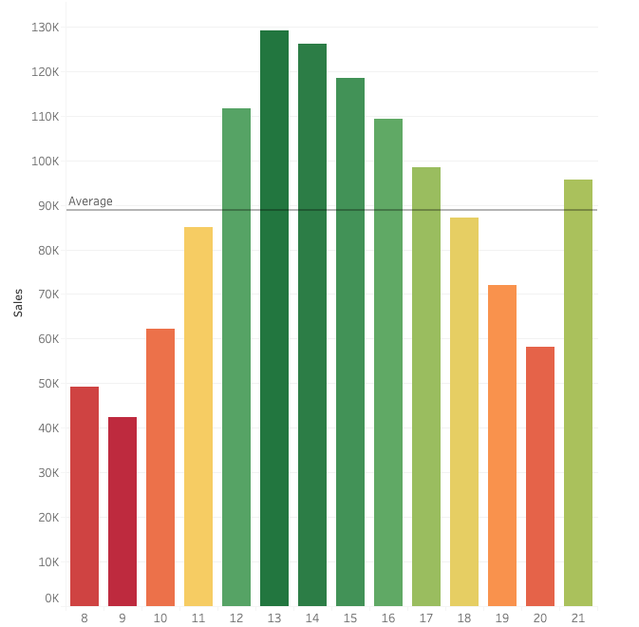
1. What is the sales amount of the supermarket in hourly time?
During 8-12 and 17-21 of shop hour has sales below average
We should set up promotion on this period for increasing the sales

Slide 12
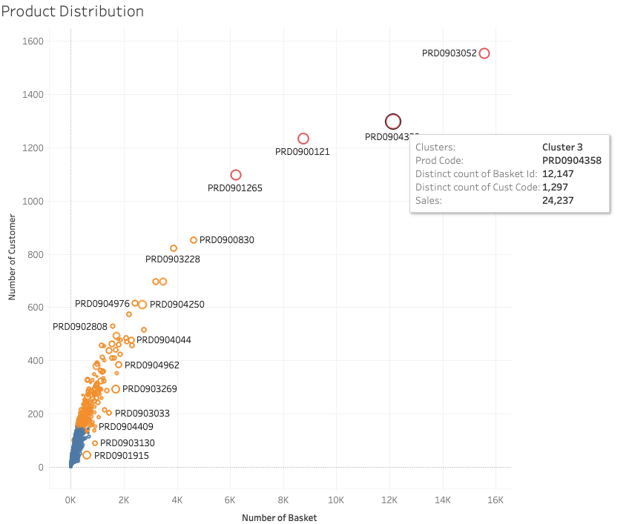
2. Which product can generate the highest sales and number of the customer?
Prd0904358 , Prd0903052, and Prd0900121 can generate good both sales and number of customer.
We can use these product profile to import a similar product for increasing the sales.
Notes:
แบ่ง cluster ทำไม และ ควรใส่ legend ด้วย

Slide 13
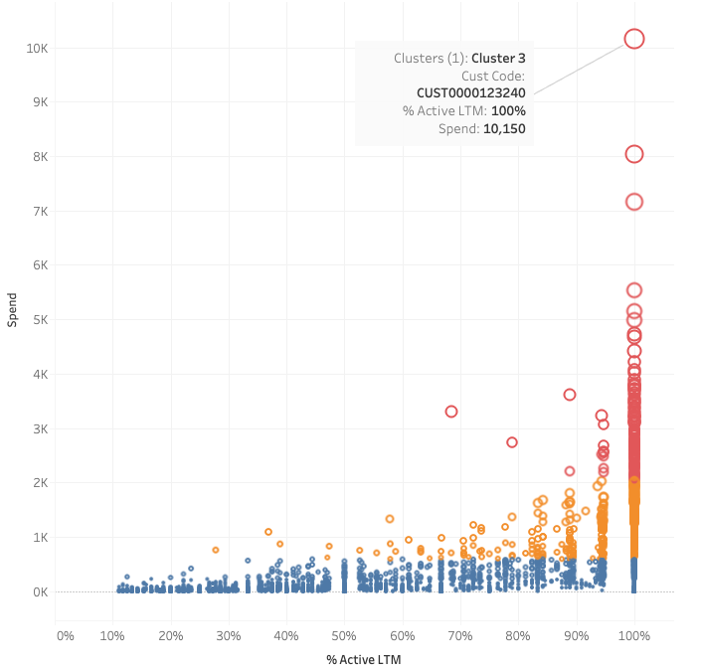
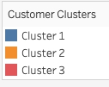
3. What customer distribution look like?
The more % active LTM, the more chance of customer spending is increased.
Customer cluster 3 is the cluster we should maintain their spending
Customer Cluster 2 is the cluster we should focus on to increase their spending
Customer Cluster 1 with high % active LTM we have plenty of room to improve the sales

Slide 14
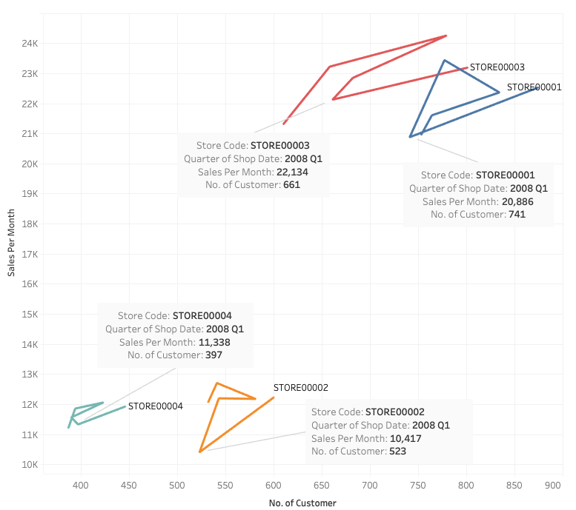
4. Which store has the most top performance?
Store00003 and Store 00001 are the top performance.
At 2008 Q1 the sales per month decrease every store; therefore, the cause of sales drop should not come from location.

Slide 15
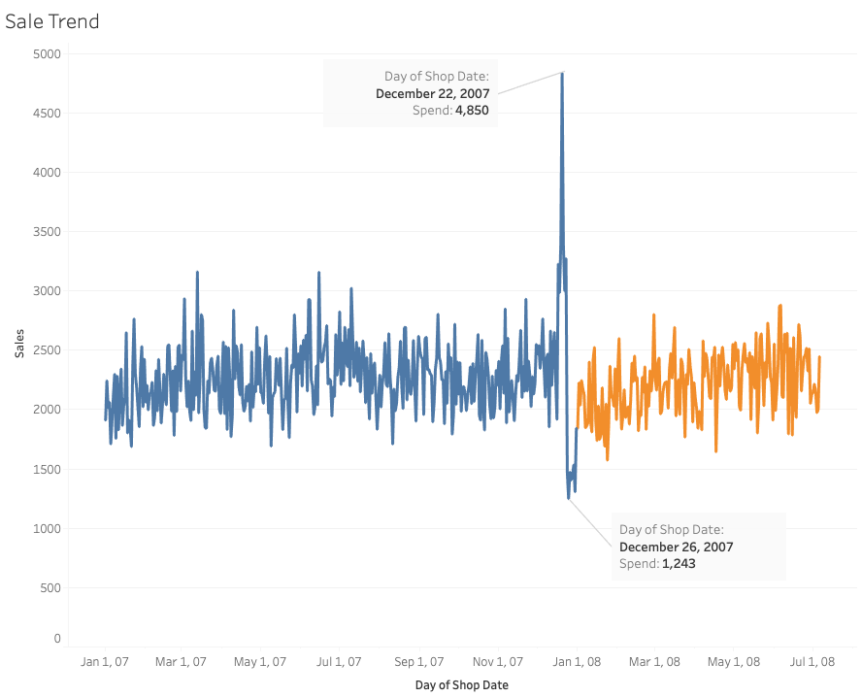
Other interesting insight
There has a peak of sale at December 22, 2007 and Lowest point at December 26, 2007.
It could be the Christmas day that many people go out for shopping and stay at home after that
Notes:
ปีกกา chris effect

Slide 16
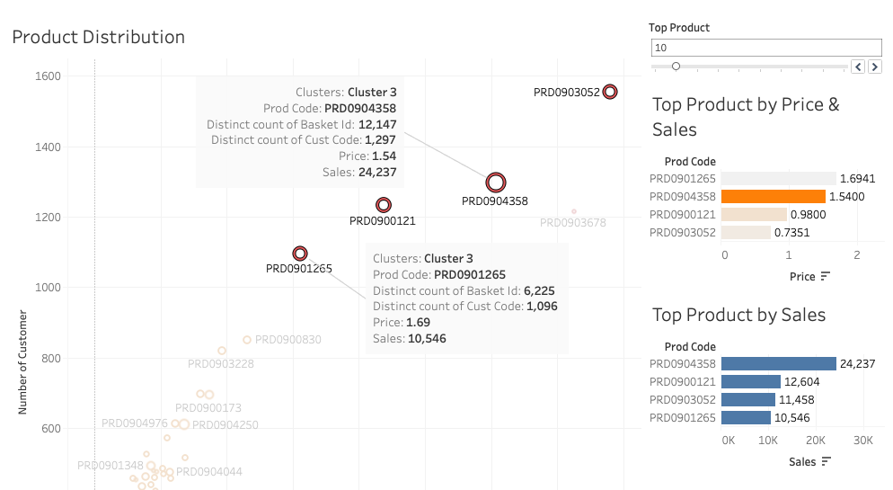
Other interesting insight
The product that generate great number of customer and sales has price between 0.7 – 1.70
We can use product which these price to increase number of customer.

Slide 17
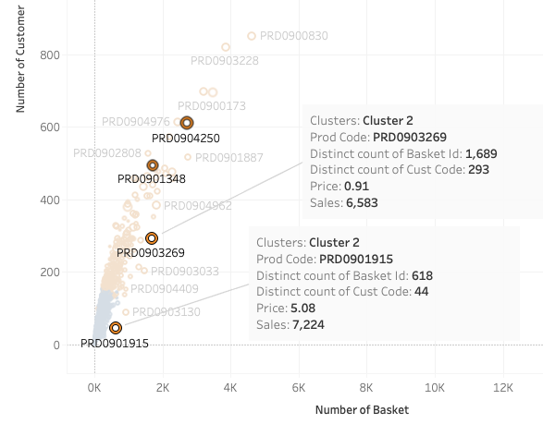
Other interesting insight
There are some product that did not generate great number of customer but still generate good sales.

Slide 18
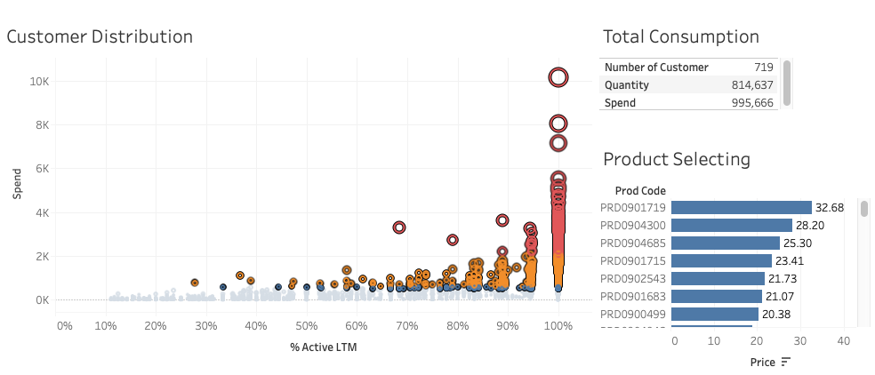
Other interesting insight
The number of customer in cluster 3 and 2 is 719/4,891 = 14.7%
can generate sales up to 995,666/1,244,919 = 80.0%
which follow the Pareto principle (80/20 rule).
Notes:
According to above chart, customer cluster 3 and 2 have the number of customer is 719/4891 = 14.7% can generate sales up to 995,666/1,244,919 = 80.0% which follow the Pareto principle (also known as the 80/20 rule, the law of the vital few) states that, for many events, roughly 80% of the effects come from 20% of the causes.

Slide 19
Conclusion (Business in Action)
During 8-12 and 17-21 of shop hour should set up promotion.
Importing the product that similar to Prd0904358, Prd0903052, and Prd0900121 for increasing the sales
The more % active LTM, the more chance of customer spending is rising. We should figure out the way to improve % active LTM, and it will increase the chance of increasing sales.
The Products priced from 0.7 - 1.7 can attract more customers which can improve % active LTM.

